Slide 1
UNIT I – BASICS OF SDN
UNIT I – SESSION 1
SESSION 4
The Genesis of SDN-
software Defined Networking is Born,
Sustaining SDN Interoperability,
Open Source Contributions,
Legacy Mechanisms Evolve Toward SDN ,
Network Virtualization
Reference: Ref. 1, Ch.3.3, 3.4, 3.5, 3.6, 3.7

Slide 2
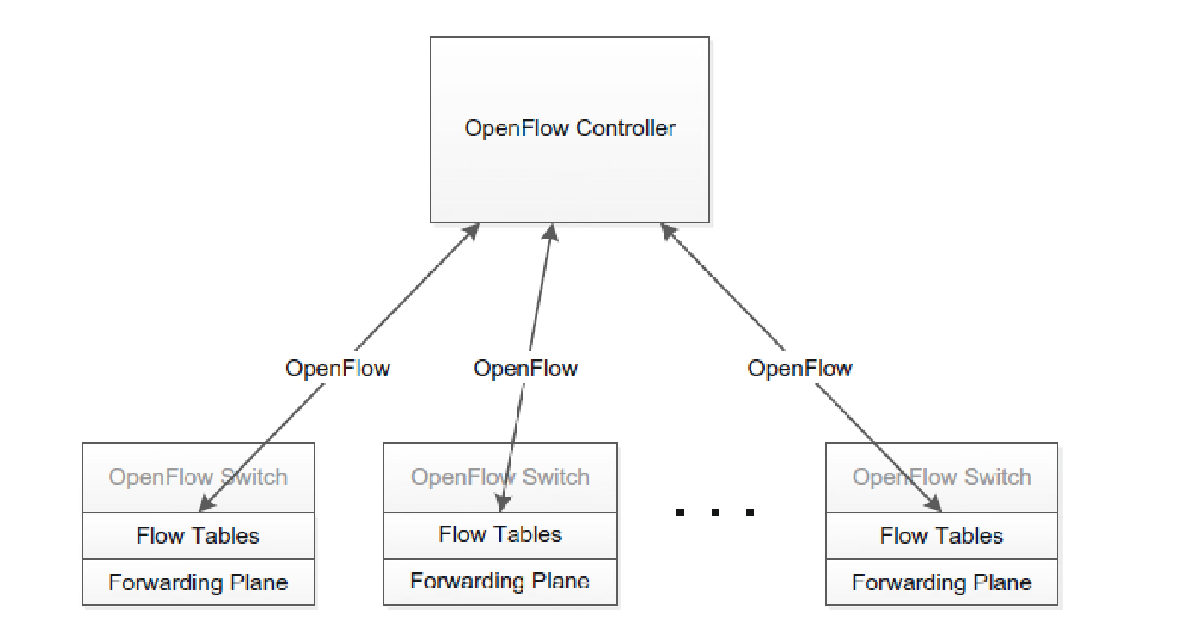
Software Defined Networking is Born-The Birth of OpenFlow
Simple architecture of an OpenFlow solution
The arrival of OpenFlow is the point at which SDN was actually born
OpenFlow is a network communication protocol used between controllers and forwarders in an SDN architecture. OpenFlow introduces the concept of flow table, based on which forwarders forwards data packets. Controllers deploy flow tables on forwarders through OpenFlow interfaces, achieving control on the forwarding plane.
• The controller populates the switch with flow table entries.
• The switch evaluates incoming packets and finds a matching flow, then performs the associated action.
• If no match is found, the switch forwards the packet to the controller for instructions on how to deal with the packet.
Typically the controller will update the switch with new flow entries as new packet patterns are received, so that the switch can deal with them locally.

Slide 3
Sustaining SDN Interoperability
It is important to ensure that the implementations of the various players in the OpenFlow space adhere to the standards as they are defined, clarify and expand the standards where they are found to be incomplete or imprecise, and in general guarantee interoperability among OpenFlow implementations.
This goal can be achieved in a few ways:
Plugfests. Plugfests, normally staged at conferences, summits, and congresses, are environments in which vendors can bring their devices and software in order to test them with devices and software from other vendors. These are rich opportunities to determine where implementations may be lacking or where the standard itself is unclear and needs to be made more precise and specific.
Interoperability labs. Certain institutions have built dedicated test labs for the purpose of testing the interoperability of equipment from various vendors and organizations. One such lab is the Indiana Center for Network Translational Research and Education (InCNTRE) at Indiana University, which hosts a large collection of vendor devices and controllers as well as experimental devices and controllers from open source contributors. We discuss open source contributions to SDN in the next section.
Certification programs. There is a need for certification of switches so that buyers can know they are getting a switch that is certified to support a particular version or versions of OpenFlow. The ONF has now implemented such a program .
Education and consulting. A complex, game-changing technological shift such as that represented by SDN will not easily permeate a large industry without the existence of an infrastructure to train and advise networking staff about the migration. It is important that a cadre of highly qualified yet vendor-neutral organizations address this need.

Slide 4
Open Source Contributions
Operating systems. The Linux operating system was developed as open source and is used today to control countless devices that we use every day, from digital video recorders (DVRs) to smartphones.
• Databases. Many of the websites we visit for news reports or to purchase products store their information and product data in databases that were developed, at least initially, by the open source community. MySQL is an example of such an open source database.
• Servers. When we access locations on the Internet, many of those servers are running application server software and using tools that have been developed over time by the open source community. For example, the open source Apache Web Server is used in countless applications worldwide.
• Security. Applying the open source model is also often considered in order to deliver more secure environments [20]. Many security products providing antivirus protection and maintaining lists of malicious sites and programs are running open source software to accomplish their tasks. OpenSSL is probably the foremost example of a widely used open source encryption toolkit.
• File sharing. The BitTorrent protocol is an example of a hugely successful open protocol used for file sharing. BitTorrent works as a P2P/overlay network that achieves high-bandwidth file downloading by performing the download of a file piecemeal and in parallel from multiple servers
Risk :The areas of risk include quality, security, timeliness, and support
Open Source Contributions to SDN: Huge advances in SDN technology are attributable to open source projects. Multiple open source implementations of SDN switches, controllers, and applications are available.

Slide 5
Legacy Mechanisms Evolve Toward SDN
The urgent need for SDN could not wait for a completely new network paradigm to be fleshed out through years of research and experimentation. It is not surprising, then, that there were early attempts to achieve some SDN-like functionality within the traditional networking model. One such example was Cisco’s policy-based routing .
The capabilities of legacy switches were sometimes extended to support detailed policy configuration related to security, QoS, and other areas.
Old APIs were extended to allow centralized programming of these features. Some SDN providers have based their entire SDN solution on a rich family of extended APIs on legacy switches, orchestrated by a centralized controller

Slide 6
Network Virtualization
network virtualization lagged behind its compute and storage counterparts and how this has resulted in a strong demand for network virtualization in the data center.
Network virtualization, in essence, provides a network service that is decoupled from the physical hardware below that offers a feature set identical to the behavior of its physical counterpart.
An important and early approach to such network virtualization was the virtual local area network (VLAN). VLANs permitted multiple virtual local area networks to co-reside on the same layer two physical network in total isolation from one another.
Although this technical concept is very sound, the provisioning of VLANs is not particularly dynamic, and they scale only to the extent of a layer two topology.
Layer three counterparts based on tunneling scale better than VLANs to larger topologies. Complex systems have evolved to use both VLAN as well as tunneling technologies to provide network virtualization solutions

Slide 7
Nicira-NV
One of the most successful commercial endeavors in this space was Nicira, now part of VMware.
Early on, Nicira claimed that there were seven properties of network virtualization:
1. Independence from network hardware
2. Faithful reproduction of the physical network service model
3. Following an operational model of compute virtualization
4. Compatibility with any hypervisor platform
5. Secure isolation among virtual networks, the physical networks, and the control plane
6. Cloud performance and scale
7. Programmatic network provisioning and control
Several of these characteristics closely resemble what we have said is required from an SDN solution. SDN promises to provide a mechanism for automating the network and abstracting the physical hardware below from the Software Defined Network above.
Nicira is a company focused on software-defined networking (SDN) and network virtualization. Nicira created their own proprietary versions of the OpenFlow, Open vSwitch, and OpenStack networking projects.[1]

